Slide 1

MANIPUR TECHNICAL UNIVERSITY
Takyelpat, Imphal, Manipur - 795004
Water Level Monitoring System using Microcontroller
By
Naorem Diyabarta Singh
Team Leader & Member
Ricky Thoudam
Team Member
Naoroibam Lanngamba Luwang
Team Member
diyabarta_n21@mtu.ac.in
ricky_th21@mtu.ac.in
lanngamba_n21@mtu.ac.in
Course Name: Internet of Things (CS4760)
Course Faculty: Dr. Hanjabam Saratchandra Sharma
20 January 2025

Slide 2
Table of Contents
Introduction
Problem Statement
Solution to the Problem
Unique Selling Proposition (USP)
Required Components
System Architecture
Diagram of System Implementation
User Interface
Environmental Impact
Future Enhancements
Conclusion

Slide 3
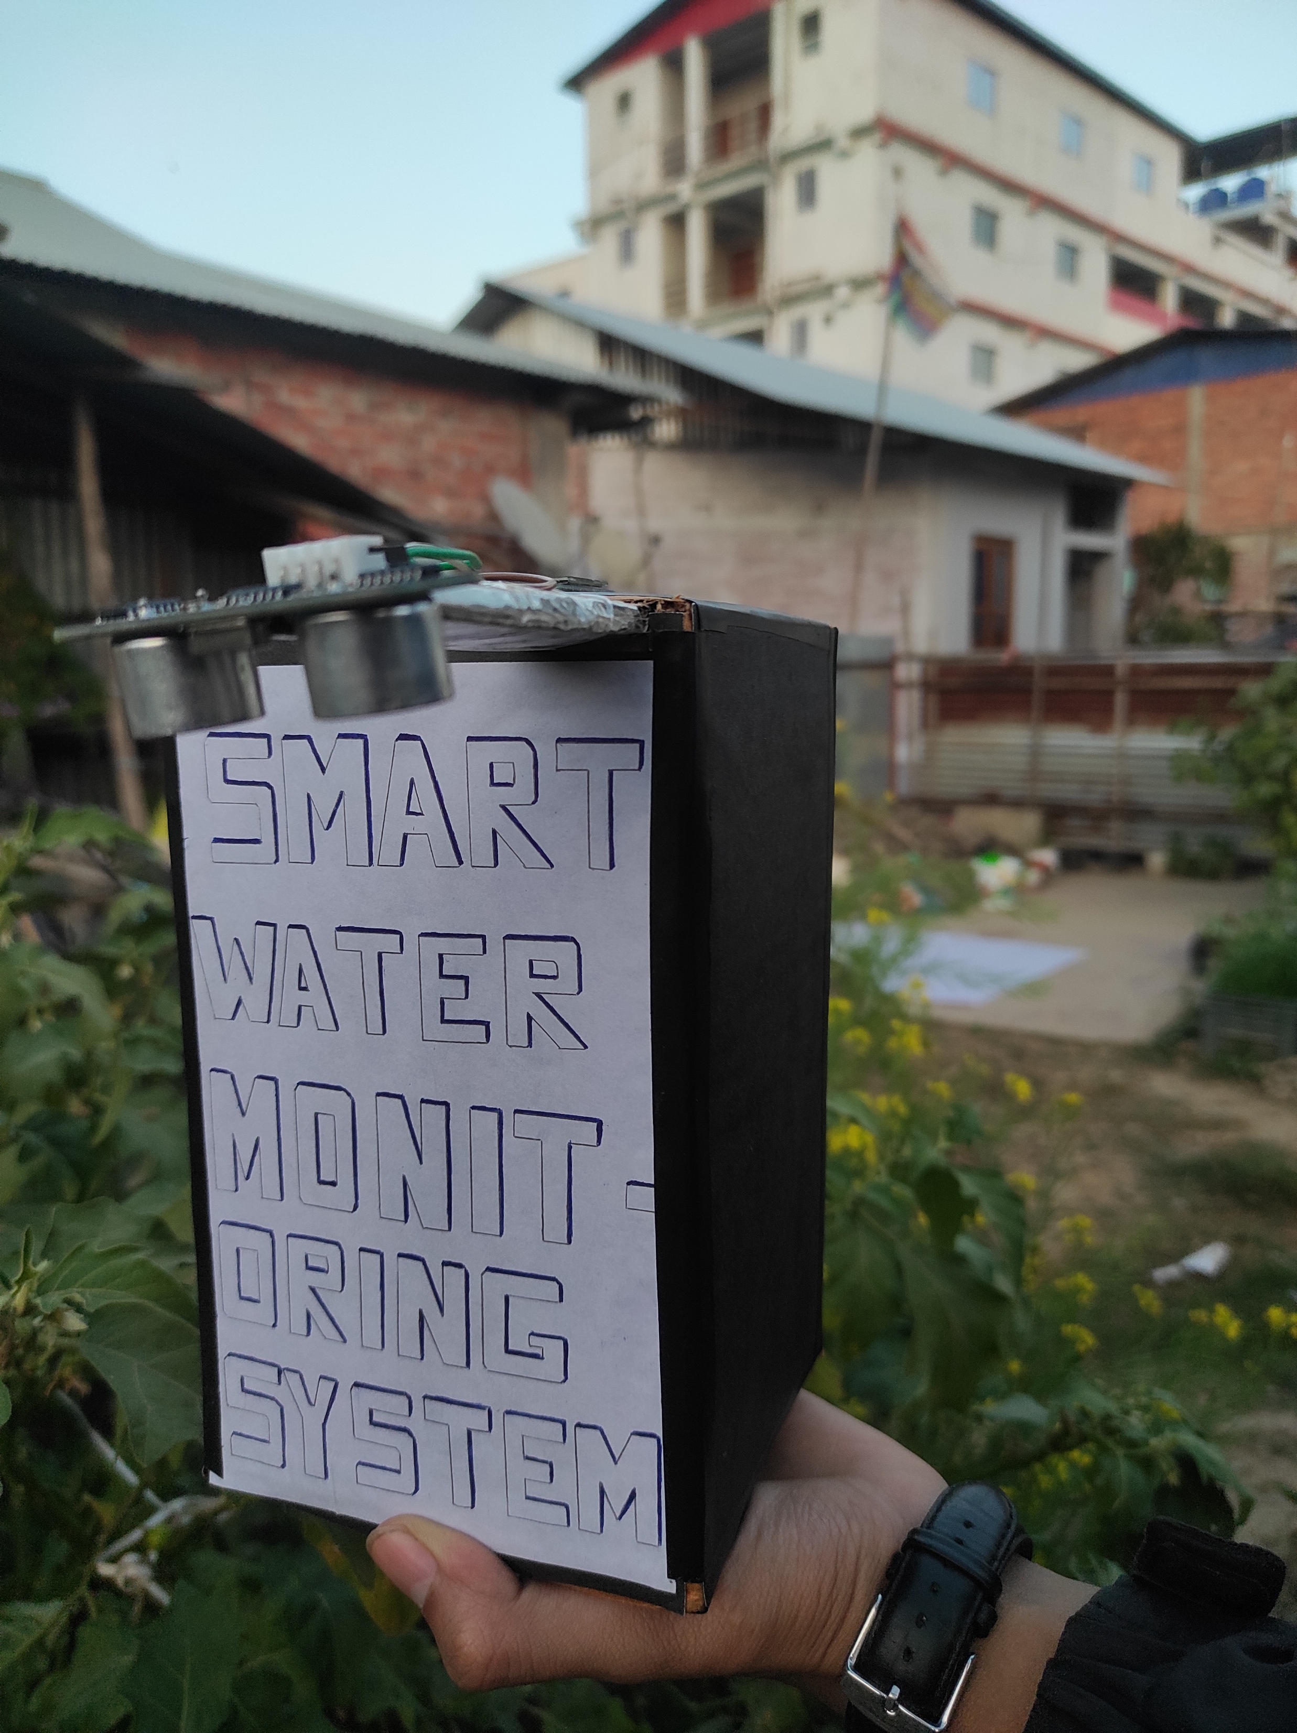
Introduction
Why This Project Matters: Address global water scarcity challenges.
Role of IoT: Automating water level monitoring.
Objective: Build a smart system for efficient water management.
3

Slide 4

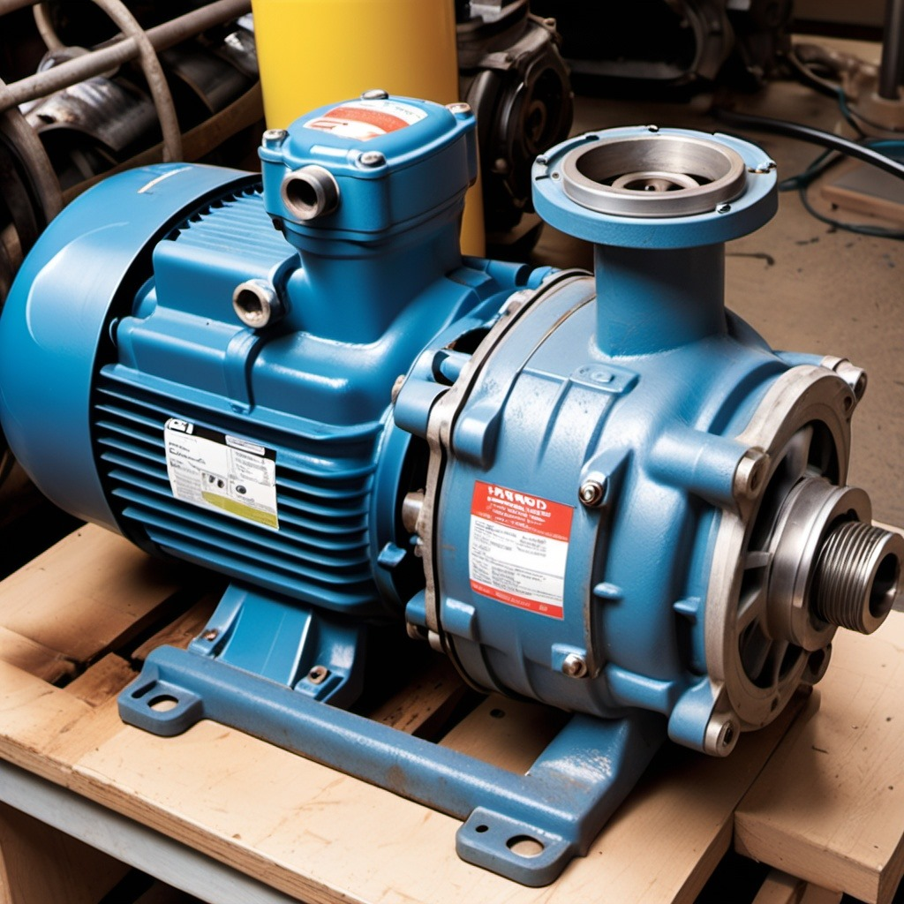
Problem Statement
Human Dependency: Constant human supervision is required, making the process inefficient.
Pump Damage: Running pumps without water can cause motor damage due to dry running.
4

Slide 5
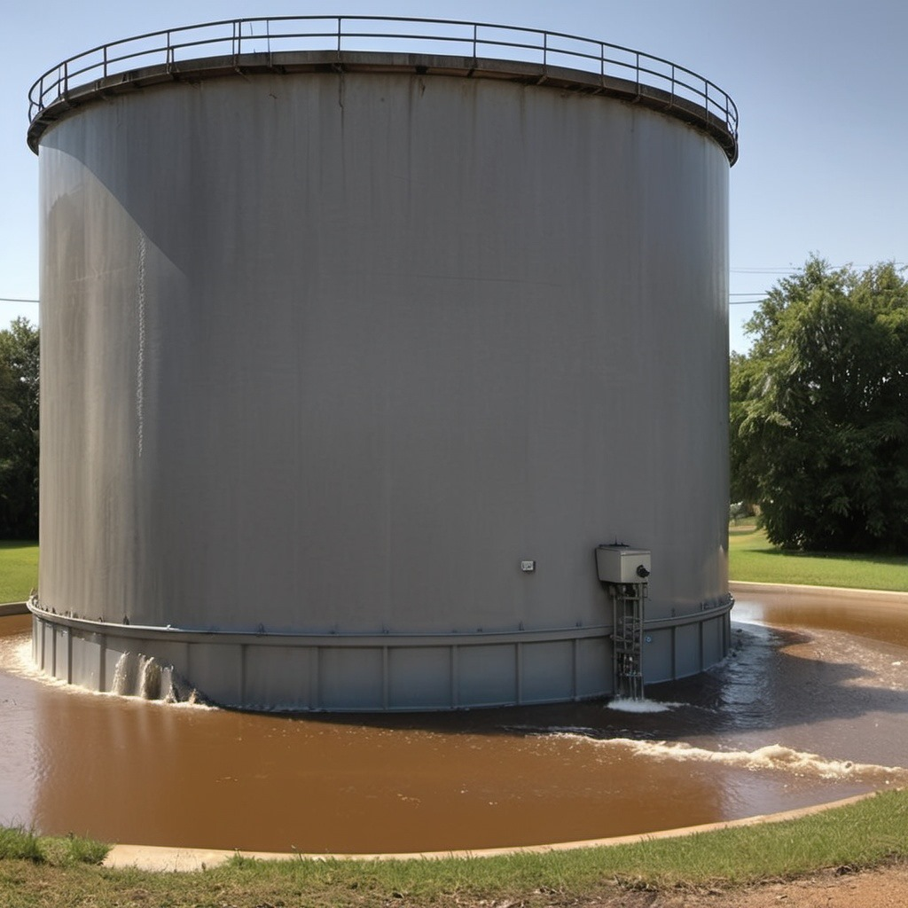
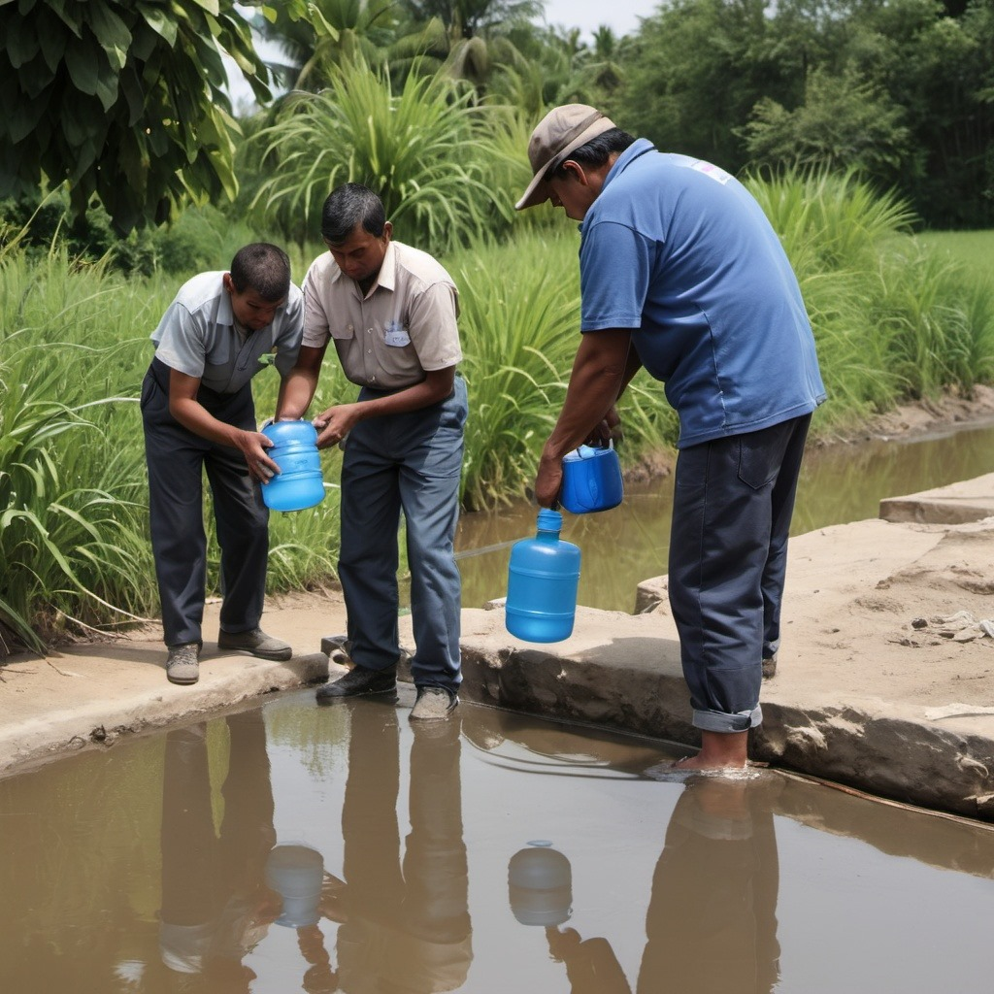
Problem Statement
Lack of Alerts: No real-time notifications or alerts for critical water levels.
Inconvenience: Manual checking of water levels is time-consuming and labor-intensive.
5

Slide 6
Solution to the Problem
Real-time monitoring with sensors.
OLED display and web interface provide instant water level updates.
Buzzer alerts, reducing the manual water level check.
Instant alerts on mobile or web dashboard.
6

Slide 7
Unique Selling Proposition (USP)
Durability for harsh conditions.
Real-time alerts to prevent wastage.
User-friendly interfaces and affordable design.
7

Slide 8
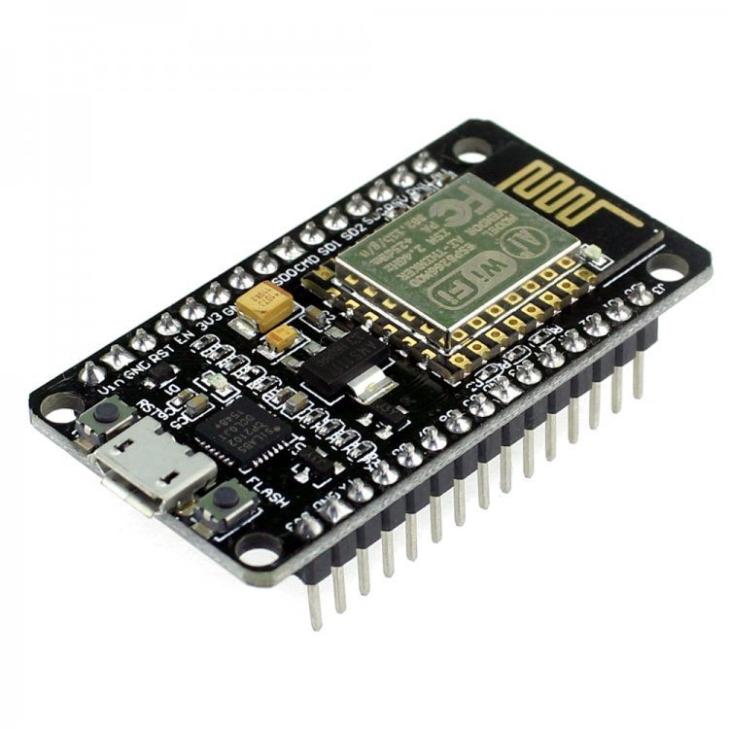
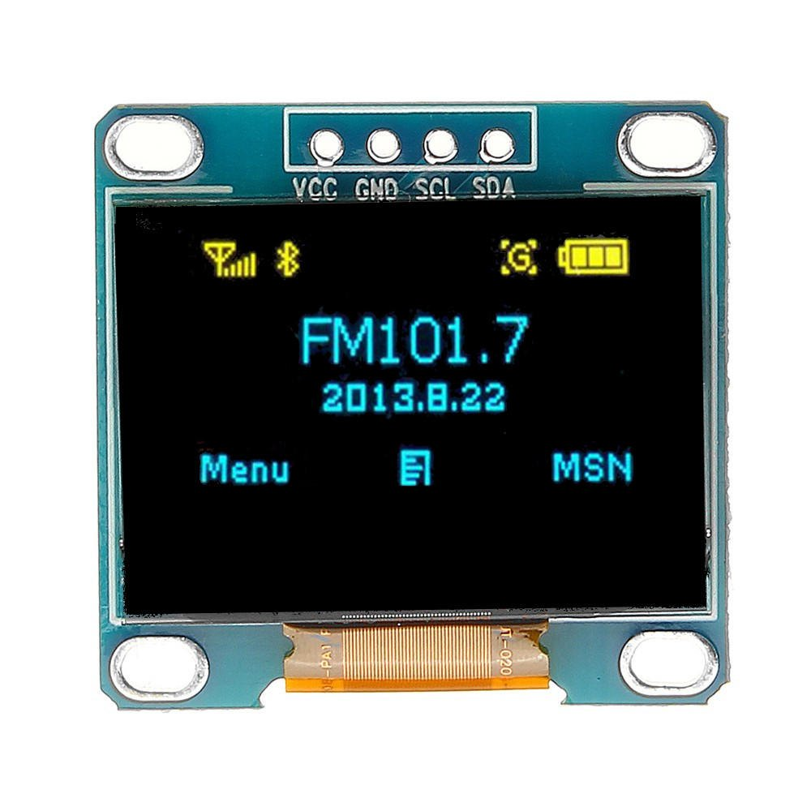

Required Components
ESP8266 Node MCU
(Microcontroller)
Ultrasonic Sensor
HC-SR04
0.96’’ OLED display
Blynk Web and mobile app
Buzzer
Jumper Wires

Slide 9
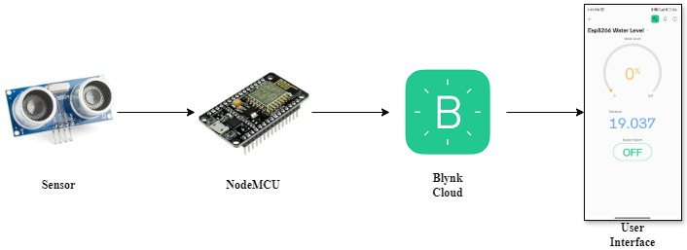
System Architecture
Components interact to monitor and manage water.

Slide 10
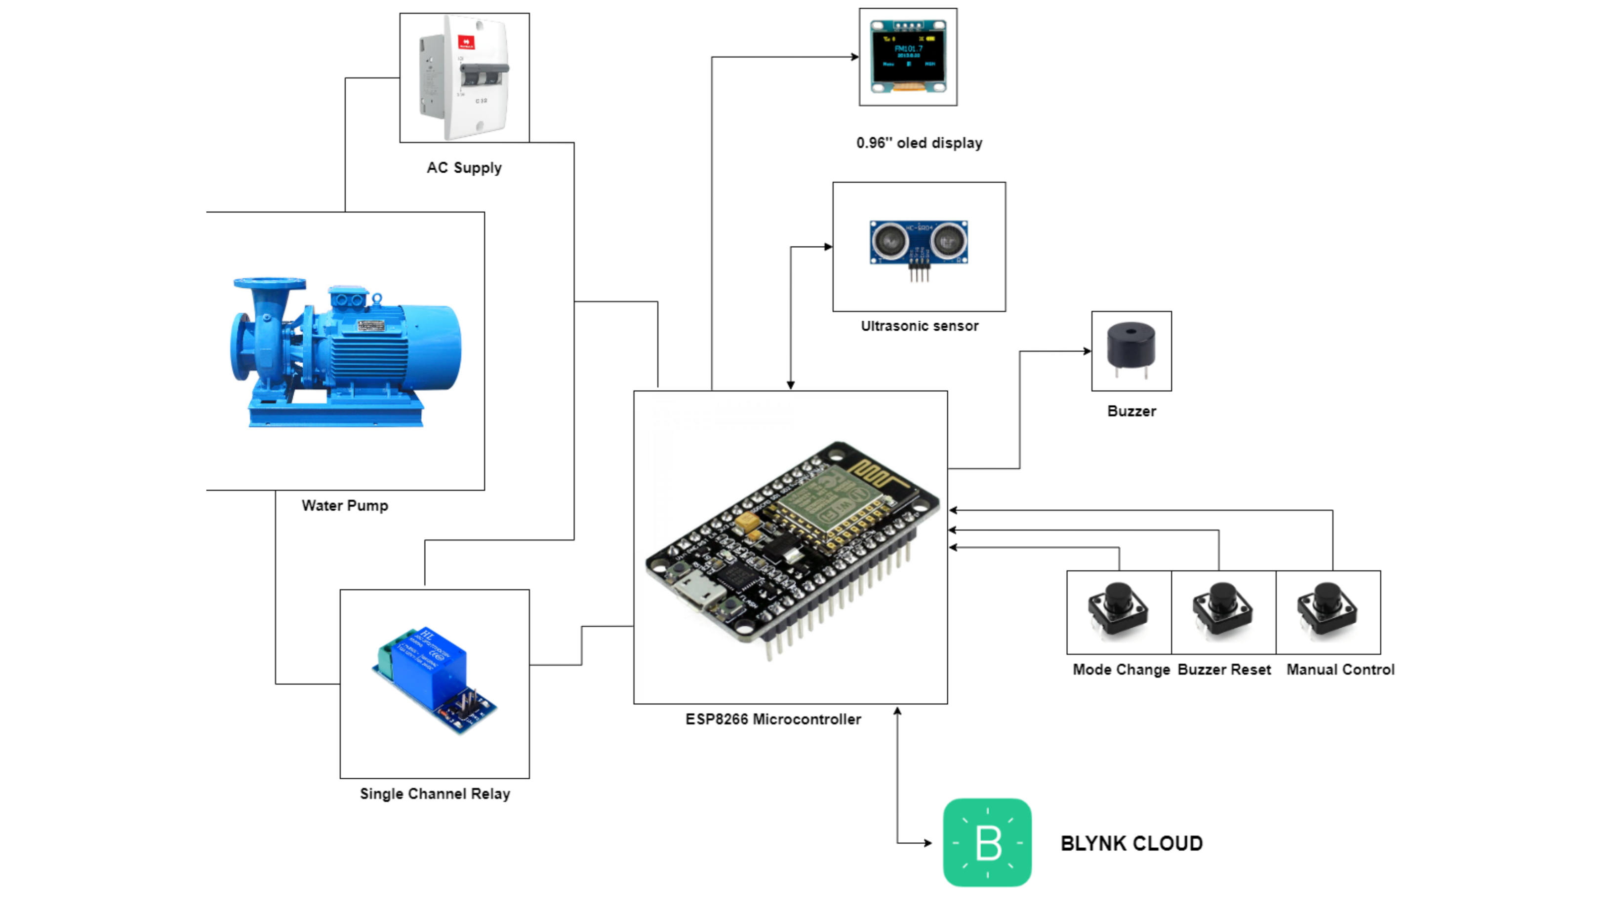
Diagram of System Implementation

Slide 11

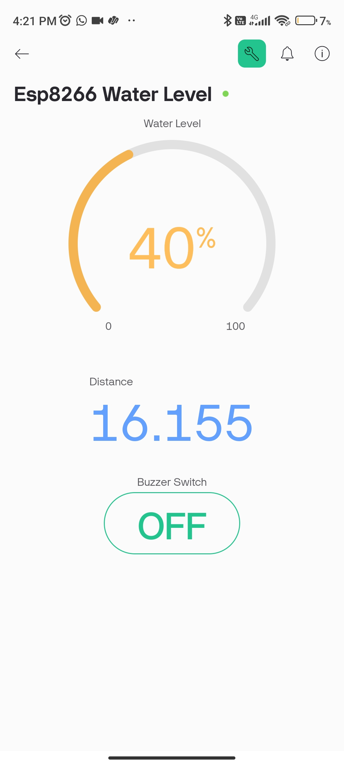

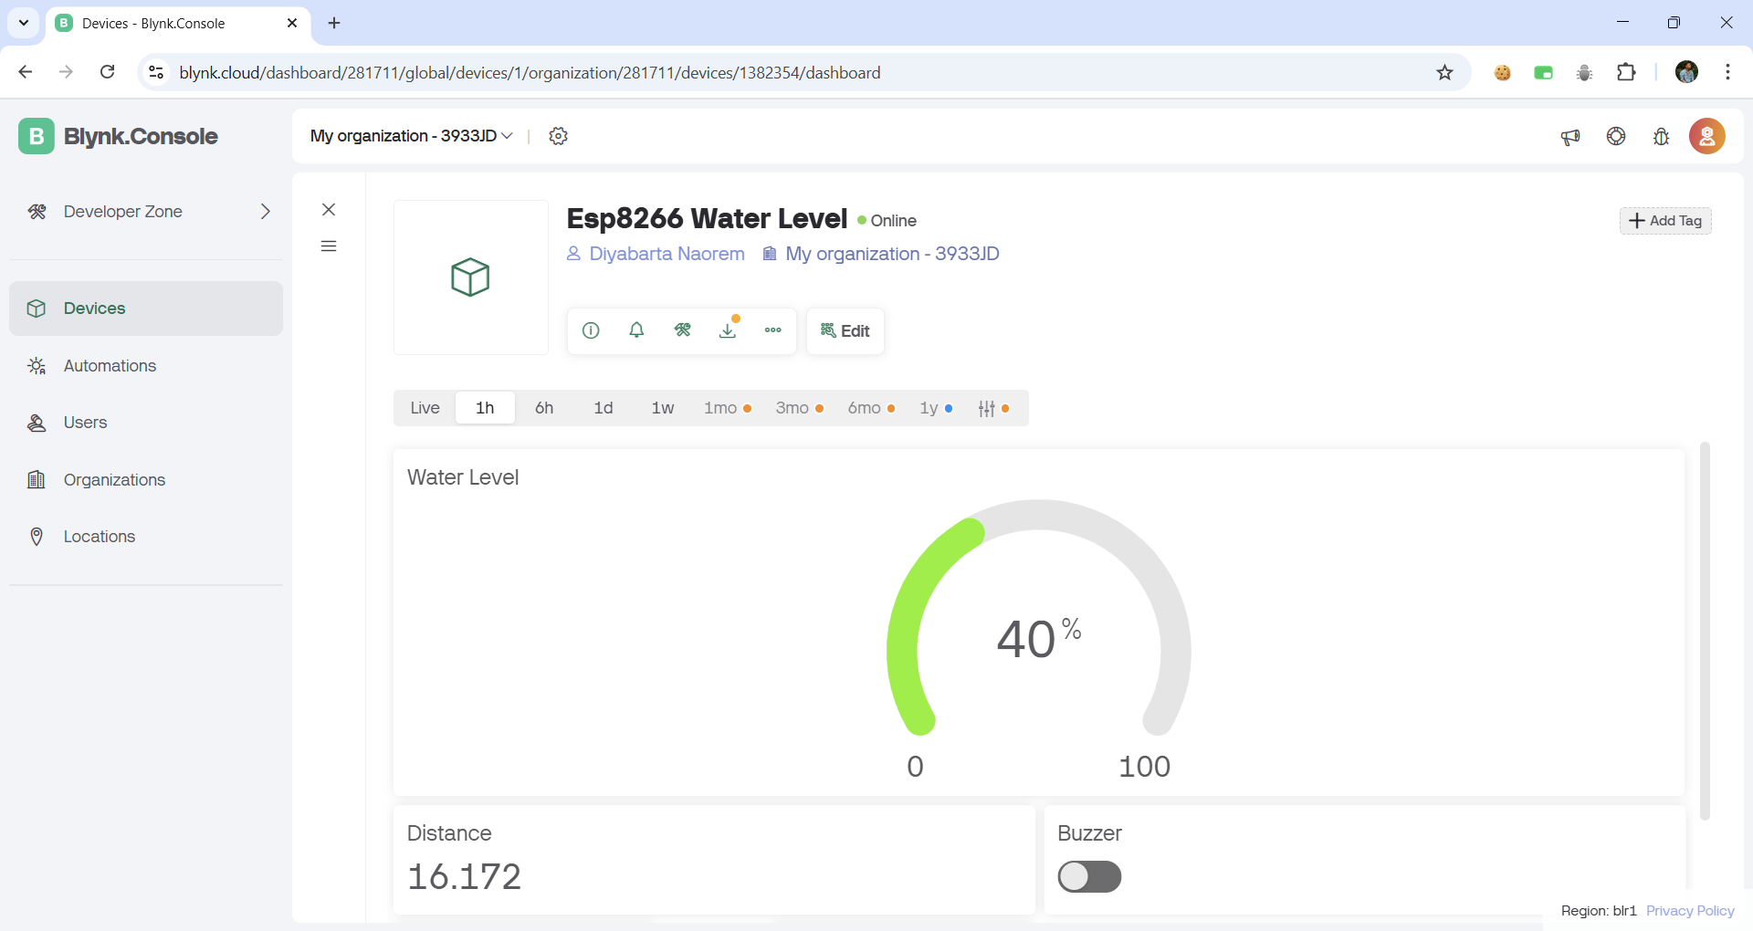
User Interface
Blynk App Features
Web Dashboard

Slide 12
Environmental Impact
Water Conservation: Prevents overflow and wastage.
Energy Efficiency: Reduces unnecessary pump operation.
Sustainability: Encourages responsible water usage.

Slide 13
Future Enhancements
Integration with automated pump system
Waterproof ultrasonic sensor (JSN-SR04T)
Solar Power Integration
Leakage Detection

Slide 14
Conclusion
Key Takeaways: Combines IoT and automation for critical challenges.
Call to Action: Highlight adoption potential and encourage feedback.

Slide 15

Thank You

